Slide 1


Big Data Analytics
PATTERN BASED CHANGE DETECTION ALGORITHMS APPLIED TO CLIMATE DATA
Computer Science
AY 2022/2023
Lorenzo Capocchiano
Domenico Narracci

Slide 2

Climate change
In the last years we are assisting to an increase in environmental pollution.
This inevitably leads to changes in climate causing a lot of issues for humans and all living species.
How this changes are quantifiable?
Is possible to define an objective criterion about actual changes in climate?

Slide 3
Objectives
Retrieve and analyze climate data over last decades
Discover pattern starting from data
Detect how and to what extent climate has been changed over the time

Slide 4

Big Data Analytics
Complex process of big data examination to discover new information useful for organizations and public administrations

Slide 5
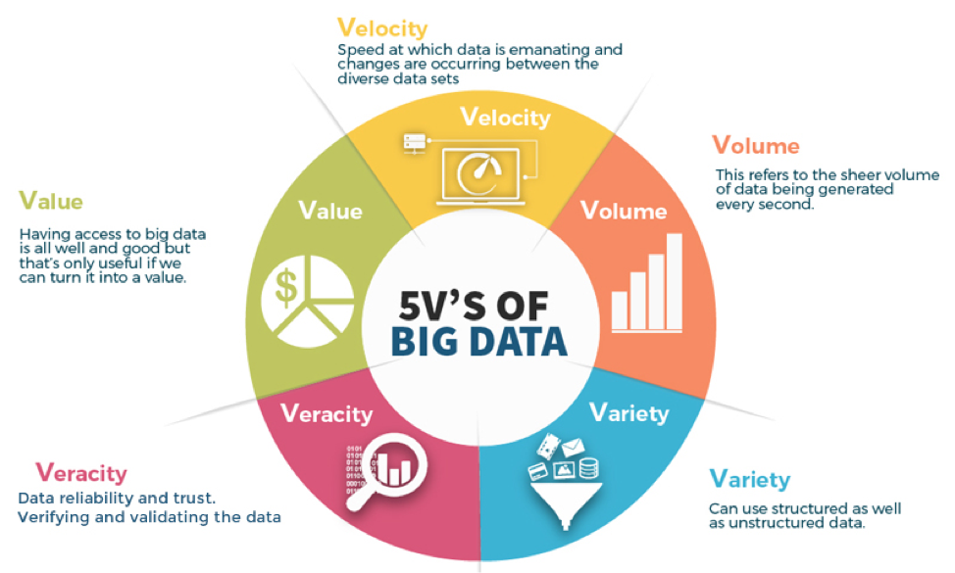

Slide 6

Which data
Global Historical Climate Network includes daily land surface observations from around the world
The dataset includes observations from World Meteorological Organization, Cooperative, and CoCoRaHS networks.

Slide 7
Which data
Climate data for Louisiana and Mississippi
STATION_NAME (max 50 characters) is the name of the station (usually city/airport name).
DATE is the date of the record in the format ‘yyyy-MM-dd’
AWND - Average daily wind speed m/s
PRCP - Precipitation in mm
SNOW - Snowfall in mm
TMAX - Maximum temperature in Celsius
TMIN - Minimum temperature in Celsius
TOBS - Temperature at the time of observation in Celsius
STATION | NAME | DATE | AWND | PRCP | SNOW | TMAX | TMIN | TOBS
USC00226308 | NEWTON EXPERIMENTAL STATION, MS US | 01/01/2006 |  | 0,0 mm | 0,0 mm | 21,1 °C | 5,0 °C | 13,3 °C
USC00226308 | NEWTON EXPERIMENTAL STATION, MS US | 02/01/2006 |  | 0,0 mm | 0,0 mm | 22,2 °C | 13,3 °C | 20,6 °C
USC00226308 | NEWTON EXPERIMENTAL STATION, MS US | 03/01/2006 |  | 0,0 mm | 0,0 mm | 26,1 °C | 6,7 °C | 6,7 °C
USC00226308 | NEWTON EXPERIMENTAL STATION, MS US | 04/01/2006 |  | 0,0 mm | 0,0 mm | 19,4 °C | 1,1 °C | 2,2 °C
USC00226308 | NEWTON EXPERIMENTAL STATION, MS US | 05/01/2006 |  | 0,0 mm | 0,0 mm | 25,6 °C | 2,2 °C | 6,1 °C
USC00226308 | NEWTON EXPERIMENTAL STATION, MS US | 06/01/2006 |  | 0,0 mm | 0,0 mm | 14,4 °C | -1,7 °C | 1,1 °C

Slide 8
STATION,"NAME","DATE","AWND","PRCP","SNOW","TMAX","TMIN","TOBS"
USC00226308,"NEWTON EXPERIMENTAL STATION, MS US","2006-01-01",,"0.0","0.0","21.1","5.0","13.3"
USC00226308,"NEWTON EXPERIMENTAL STATION, MS US","2006-01-02",,"0.0","0.0","22.2","13.3","20.6"
USC00226308,"NEWTON EXPERIMENTAL STATION, MS US","2006-01-03",,"0.0","0.0","26.1","6.7","6.7"
USC00226308,"NEWTON EXPERIMENTAL STATION, MS US","2006-01-04",,"0.0","0.0","19.4","1.1","2.2"
USC00226308,"NEWTON EXPERIMENTAL STATION, MS US","2006-01-05",,"0.0","0.0","25.6","2.2","6.1"
USC00226308,"NEWTON EXPERIMENTAL STATION, MS US","2006-01-06",,"0.0","0.0","14.4","-1.7","1.1"
USC00226308,"NEWTON EXPERIMENTAL STATION, MS US","2006-01-07",,"0.0","0.0","3.3","-6.7","-5.0"
USC00226308,"NEWTON EXPERIMENTAL STATION, MS US","2006-01-08",,"0.0","0.0","14.4","-5.0","6.1"
STATION | NAME | DATE | AWND | PRCP | SNOW | TMAX | TMIN | TOBS
USC00226308 | NEWTON EXPERIMENTAL STATION, MS US | 01/01/2006 |  | 0,0 mm | 0,0 mm | 21,1 °C | 5,0 °C | 13,3 °C
USC00226308 | NEWTON EXPERIMENTAL STATION, MS US | 02/01/2006 |  | 0,0 mm | 0,0 mm | 22,2 °C | 13,3 °C | 20,6 °C
USC00226308 | NEWTON EXPERIMENTAL STATION, MS US | 03/01/2006 |  | 0,0 mm | 0,0 mm | 26,1 °C | 6,7 °C | 6,7 °C
USC00226308 | NEWTON EXPERIMENTAL STATION, MS US | 04/01/2006 |  | 0,0 mm | 0,0 mm | 19,4 °C | 1,1 °C | 2,2 °C
USC00226308 | NEWTON EXPERIMENTAL STATION, MS US | 05/01/2006 |  | 0,0 mm | 0,0 mm | 25,6 °C | 2,2 °C | 6,1 °C
USC00226308 | NEWTON EXPERIMENTAL STATION, MS US | 06/01/2006 |  | 0,0 mm | 0,0 mm | 14,4 °C | -1,7 °C | 1,1 °C

Slide 9
STATION | NAME | DATE | AWND | PRCP | SNOW | TMAX | TMIN | TOBS
USC00226308 | NEWTON EXPERIMENTAL STATION, MS US | 01/01/2006 |  | 0,0 mm | 0,0 mm | 21,1 °C | 5,0 °C | 13,3 °C
USC00226308 | NEWTON EXPERIMENTAL STATION, MS US | 02/01/2006 |  | 0,0 mm | 0,0 mm | 22,2 °C | 13,3 °C | 20,6 °C
USC00226308 | NEWTON EXPERIMENTAL STATION, MS US | 03/01/2006 |  | 0,0 mm | 0,0 mm | 26,1 °C | 6,7 °C | 6,7 °C
USC00226308 | NEWTON EXPERIMENTAL STATION, MS US | 04/01/2006 |  | 0,0 mm | 0,0 mm | 19,4 °C | 1,1 °C | 2,2 °C
USC00226308 | NEWTON EXPERIMENTAL STATION, MS US | 05/01/2006 |  | 0,0 mm | 0,0 mm | 25,6 °C | 2,2 °C | 6,1 °C
USC00226308 | NEWTON EXPERIMENTAL STATION, MS US | 06/01/2006 |  | 0,0 mm | 0,0 mm | 14,4 °C | -1,7 °C | 1,1 °C
DATE | PERIOD | PRCP | SNOW | TMAX | TMIN | TOBS
01/01/2006 | January | 0,0 mm | 0,0 mm | 21,1 °C | 5,0 °C | 13,3 °C
02/01/2006 | January | 0,0 mm | 0,0 mm | 22,2 °C | 13,3 °C | 20,6 °C
03/01/2006 | January | 0,0 mm | 0,0 mm | 26,1 °C | 6,7 °C | 6,7 °C
04/01/2006 | January | 0,0 mm | 0,0 mm | 19,4 °C | 1,1 °C | 2,2 °C
05/01/2006 | January | 0,0 mm | 0,0 mm | 25,6 °C | 2,2 °C | 6,1 °C
06/01/2006 | January | 0,0 mm | 0,0 mm | 14,4 °C | -1,7 °C | 1,1 °C
07/01/2006 | January | 0,0 mm | 0,0 mm | 3,3 °C | -6,7 °C | -5,0 °C
08/01/2006 | January | 0,0 mm | 0,0 mm | 14,4 °C | -5,0 °C | 6,1 °C
09/01/2006 | January | 0,0 mm | 0,0 mm | 22,8 °C | 6,1 °C | 11,1 °C
10/01/2006 | January | 0,0 mm | 0,0 mm | 24,4 °C | 11,1 °C | 15,0 °C
11/01/2006 | January | 1,3 mm | 0,0 mm | 21,1 °C | 2,8 °C | 2,8 °C
12/01/2006 | January | 0,0 mm | 0,0 mm | 17,2 °C | -1,7 °C | -1,1 °C
13/01/2006 | January | 19,8 mm | 0,0 mm | 21,7 °C | -1,1 °C | 14,4 °C

Slide 10
Pattern-Based Change Detection
Temporal Data - Complex data which evolve over time
Analysis is a crucial activity
Previously observed data may disappear
Novel and unprecedented data may appear
Data evolution causes the ‘Concept Drift’ that is the statistical properties change of the target variable which the model is trying to predict over time

Slide 11
Pattern-Based Change Detection - Challenges
Efficiency
– Changes should be detected efficiently
Tempestivity
– Changes should be detected as soon as possible
Accuracy
– Detect real drifts with low number (possibly none) of false alarms
– Differently from the classification setting, ground truths (labeled datasets) are rare
Explainability
– Changes should not only be located but also supported by explanations
– Explanations should as concise as possible and readable

Slide 12

Pattern-Based Change Detection
Symbolic learning algorithm - Changes are sought by monitoring a symbolic model learned from data. The model is a collection of relational patterns discovered by pattern mining algorithms over time. Symbolic models are more human-interpretable than sub symbolic ones
Works in an unsupervised fashion - Changing data are discriminated from ordinary ones without the need of a training phase. Unsupervised learning algorithms do not need to undergo a training phase on finely-tuned training datasets before entering production, in contrast with supervised learning algorithms (e.g., decision trees).
Is a non-parametric change detection algorithm - Changes are sought without making any prior assumption on the data distribution. Traditional change detection algorithms perform statistical hypothesis testing when checking the presence of changes, while PBCDs adopt a similarity-based approach: a change is detected only when the set of patterns significantly change.
Is an explainable change detection algorithm - Detected changes can be explained by descriptive models Traditional change detection algorithms only detect changes by making decisions about their presence or absence, leaving them unexplained. PBCDs explain such decisions with a descriptive model about the occurred changes.

Slide 13

jKarma Library
Java library that allows the modular definition and easy execution of PBCD algorithms on evolving data with reduced implementation efforts.
Used to solve change detection problems on temporal data
As a rule of thumb, PBCDs are suitable for temporal data from which relational patterns can be discovered by pattern mining algorithms.

Slide 14
jKarma library
The only strict requirement is that data are presented to PBCDs as transactions
a unique transaction id (tid, for short)
a timestamp indicating when the transaction has been registered
a set of items associated with the transaction
Time windows
jKarma embraces the streaming setting by adopting time windows in which only some transactions are kept
Without memory | BlockwiseSliding | BlockwiseLandmark
With memory | CumulativeSliding | CumulativeLandmark

Slide 15
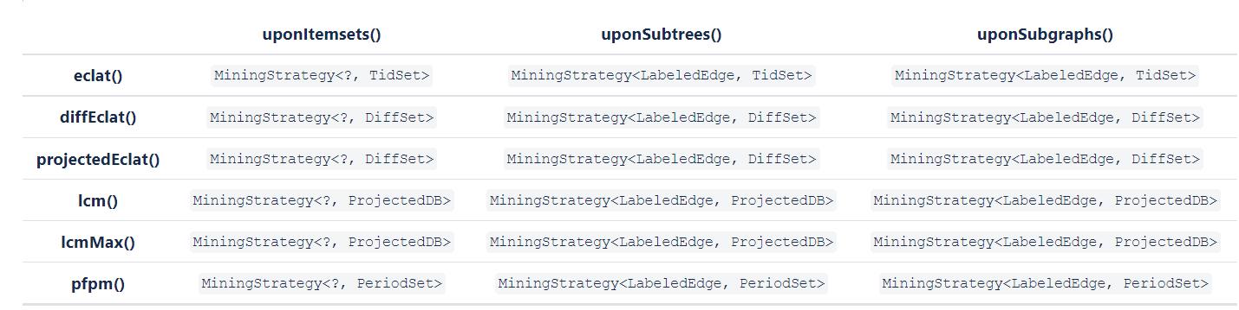
jKarma library
Alternative mining strategies in jKarma
We use frequent itemset strategy

Slide 16
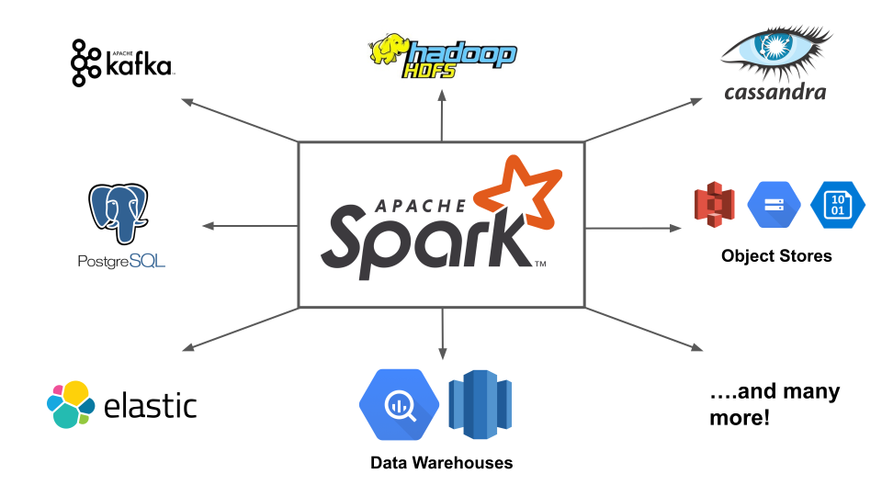
Apache Spark
Apache Spark is a unified analytics engine for large-scale data processing with built-in modules for SQL, streaming, machine learning, and graph processing.
Spark can run on Apache Hadoop, Apache Mesos, Kubernetes, on its own, in the cloud—and against diverse data sources.

Slide 17

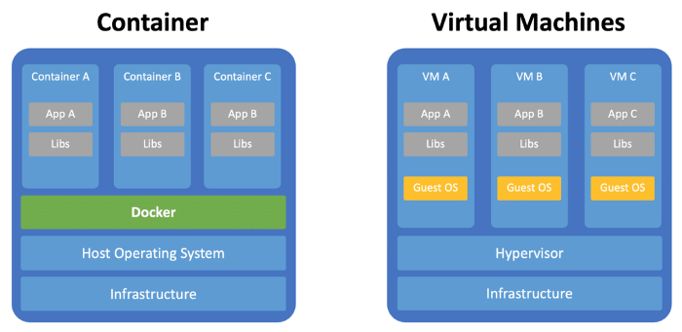
Docker
Docker makes development efficient and predictable
Build
Share
Run

Slide 18
Our project structure
A Docker container that host a master of Spark running in standalone mode and N containers workers which do the stuff.
.jar of a Java Project which uses jKarma for PBCD algorithm.
Docker volume as shared memory between containers for getting CSV files about climate data detections.

Slide 19
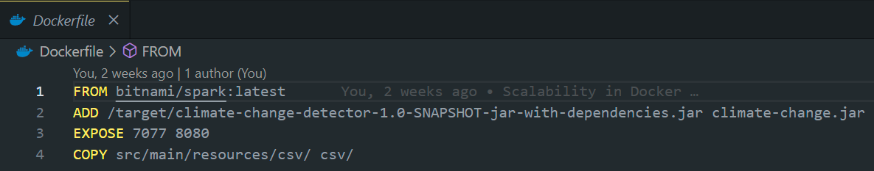

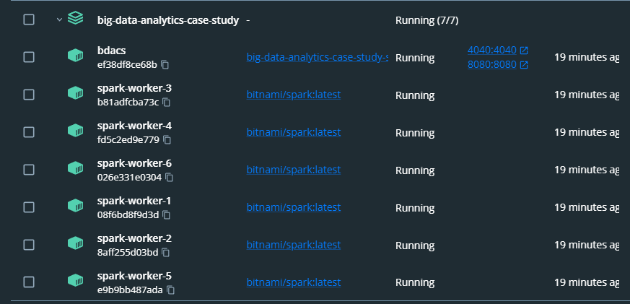
Docker Structure
docker-compose up --scale spark-worker=<num of workers>
In our example num of workers = 6

Slide 20
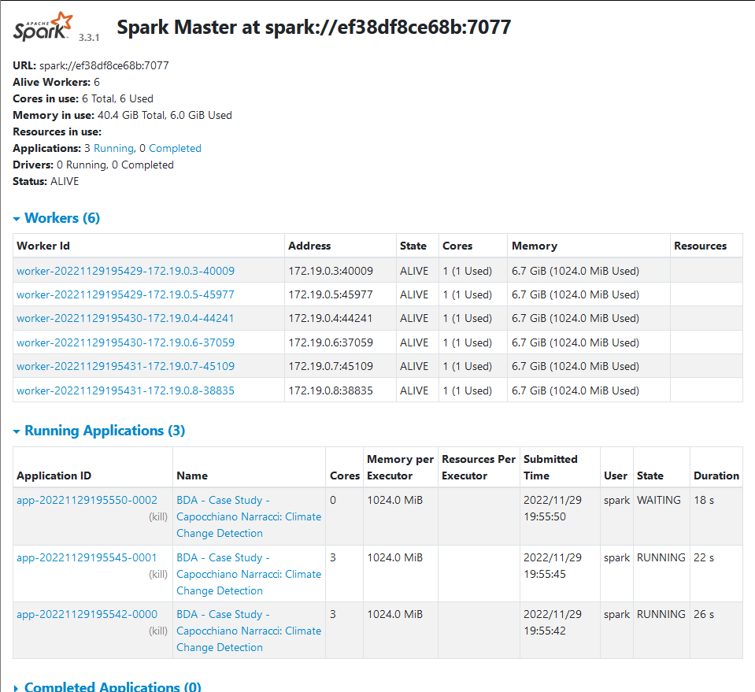
Spark UI

Slide 21
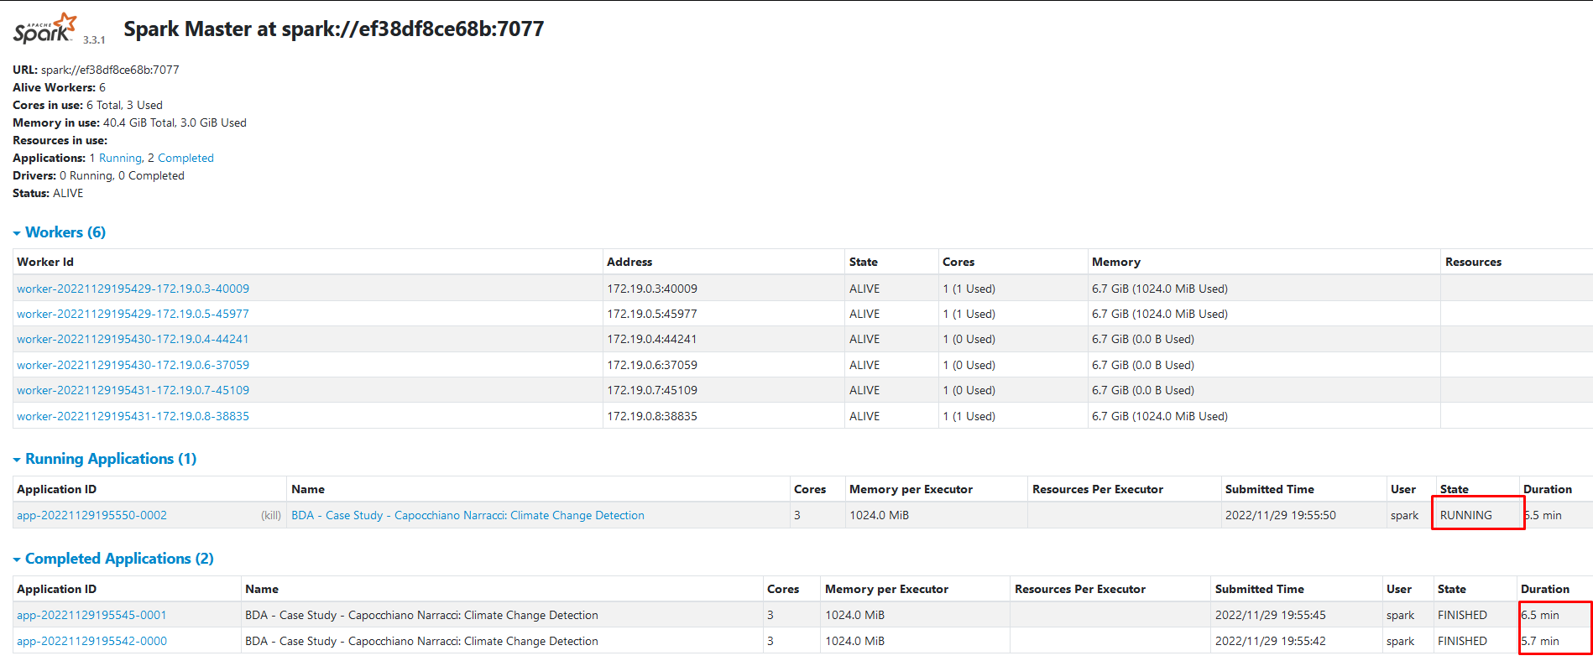
Spark UI

Slide 22
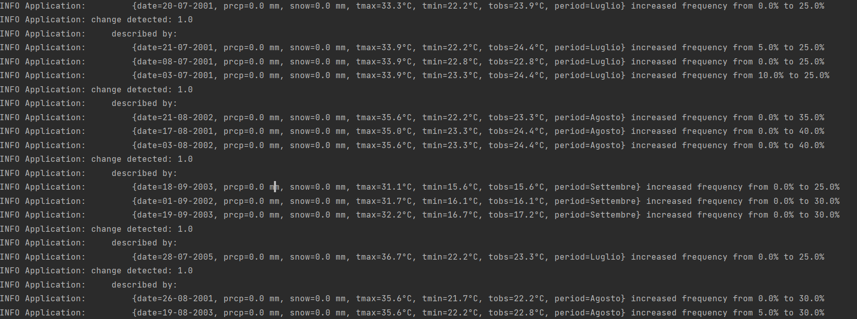
PBCD at work

Slide 23
Future developments
Using different mining strategy on jKarma and compare results
Using containers orchestrator such as MESOS or Kubernetes for better scaling and performance
Fine tuning PBCD algorithm by implementing specific domain pattern mining strategies
Improve data quality and volumes by retrieving data for different places and from different sources

Slide 24
GitHub Repository
https://github.com/lorenzokyne/big-data-analytics-case-study
Documentation:
In README file there is the procedure to startup the project with Docker containers
Under /src/main/resources/ there are CSVs and this presentation
THANKS FOR YOUR ATTENTION

